Slide 1
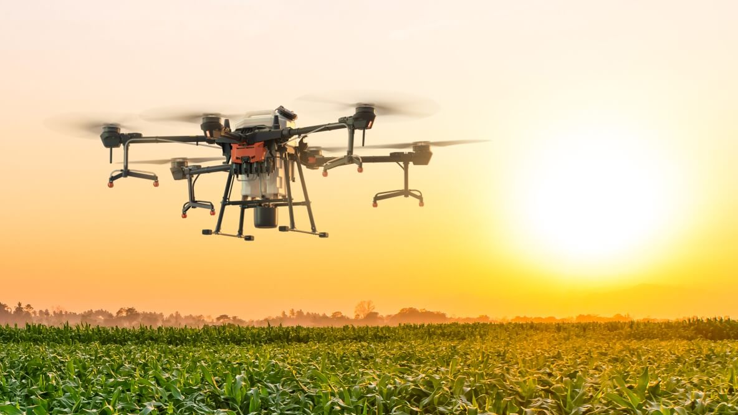
Laravel Project 2023
Agricultural Drone API

Slide 2
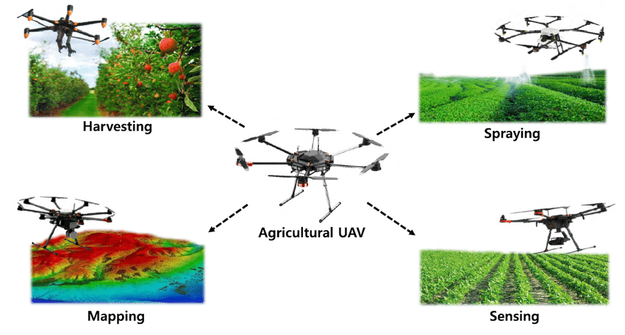
Types of Unmanned Aerial Vehicle (UAV or “drone”)

Slide 3
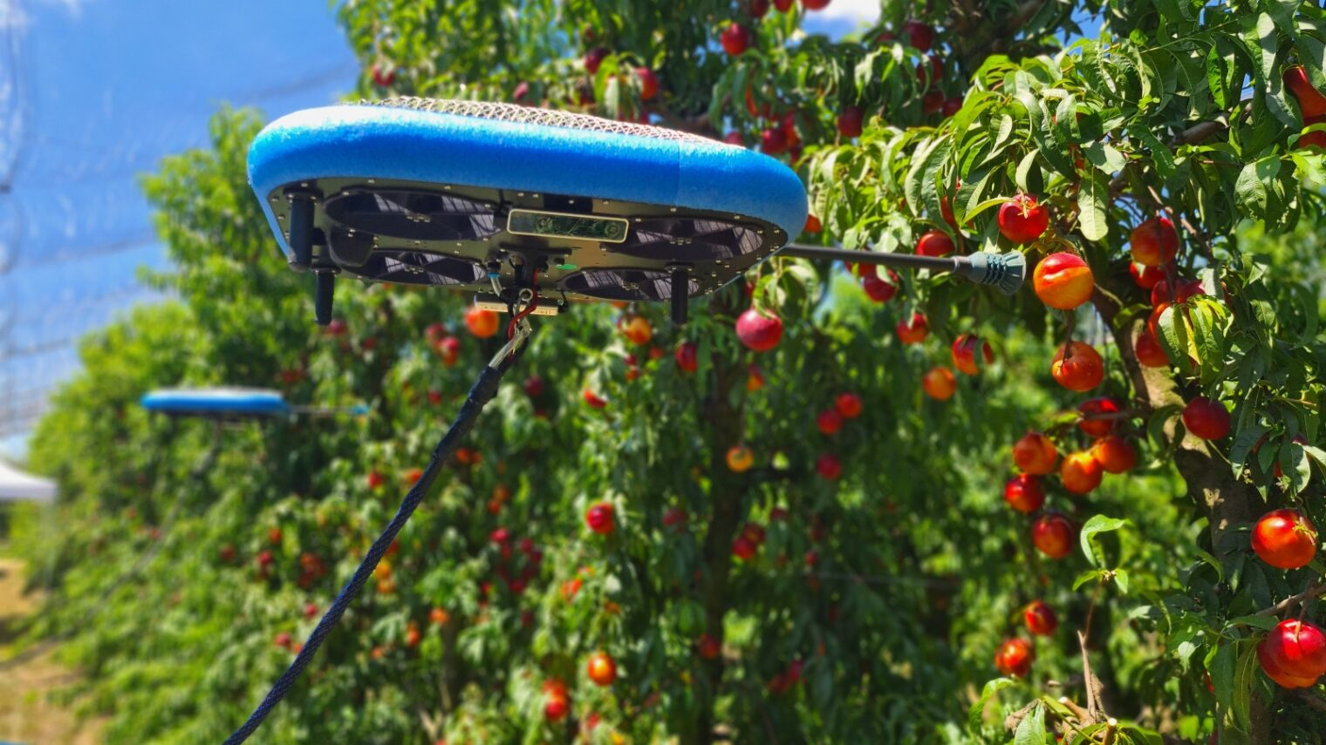
https://youtu.be/xzOf4-WaXzE?t=60

Slide 4
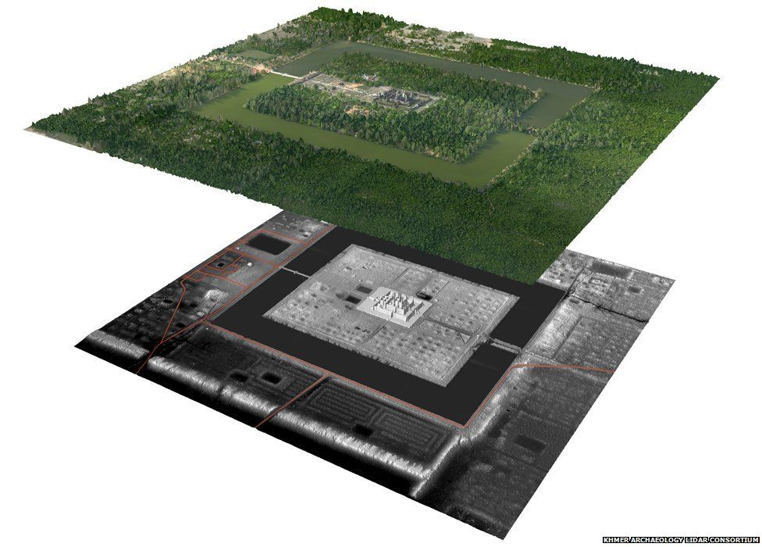

Slide 5

Plan Example (simplified)
Spray the field in the given area, at 76% strength
{
"id": "5605c0e5752afc005a000004",
"type": "SPRAY"
"datetime": "2023-05-20 12:00:00",
"area": "POLYGON((11.9924000,105.4645030 11.9924006,105.4645057 11.9924102,105.4645254))",
"spray_density": 76
}

Slide 6
As a farmer…
Remember to Authenticate
GET Request
/drones | List my drones
/drones/D23 | Output information about drone id D23
/drones/D23/location | Show current latitude+longitude of drone D23
/maps | Show a list of the map images our drone cameras made
/maps/KampongCham/7 | Download map photo the drone took of KC Farm #7

Slide 7
As a farmer…
POST Request
/plans/plan/ | Add a new spraying, seeding, mapping or sensing plan to the plan database
PUT Request
/drones/D23 | Instruct drone D23 to enter run mode with a given plan
DELETE Request
/maps/KampongCham/7 | Delete the image of KC Farm 7

Slide 8
As a drone…
(or in Thunder Client)
GET Request
/instructions | Request new instructions, if any
/plans/order66 | Request plan named “order66” from plan database (as specified in the new instructions)
POST Request
/maps/KampongCham/7 | Add a newly taken mapping image for farm 7 in Kampong Cham
PUT Request
/drones/D23/ | Update the system of current status (battery, payload, location etc)

Slide 9

What should the data contain?
This is a research exercise! How do you think a drone should work?
For this project we use a fictional drone, so you can write the specifications any way you want, but they should make sense.
You must decide for yourself what a plan should contain, what instructions should look like, what are the different kinds of system status, what kind of information can we return about the drones, etc.
Decide how to structure the JSON appropriately.

Slide 10
Additional Reading
To see a real-world version of a drone API, visit https://help.dronedeploy.com/hc/en-us/sections/1500000794002-API
(API documentation links are in the bottom half of that web page)
This link is for reference only, don’t copy this API exactly

Slide 11

Project Deliverables
Please submit a github repo containing all of:
A Laravel project implementing the API requirements
Documentation for your API
A SQL file containing your schema and test data (if any)
Thunder or Postman test files showing examples of every API call (see https://learning.postman.com/docs/getting-started/importing-and-exporting-data/ or https://github.com/rangav/thunder-client-support#importexport )
Keep a working copy of your project and tests on your laptop, as you will be asked to demonstrate each test during your presentation

